Slide 1

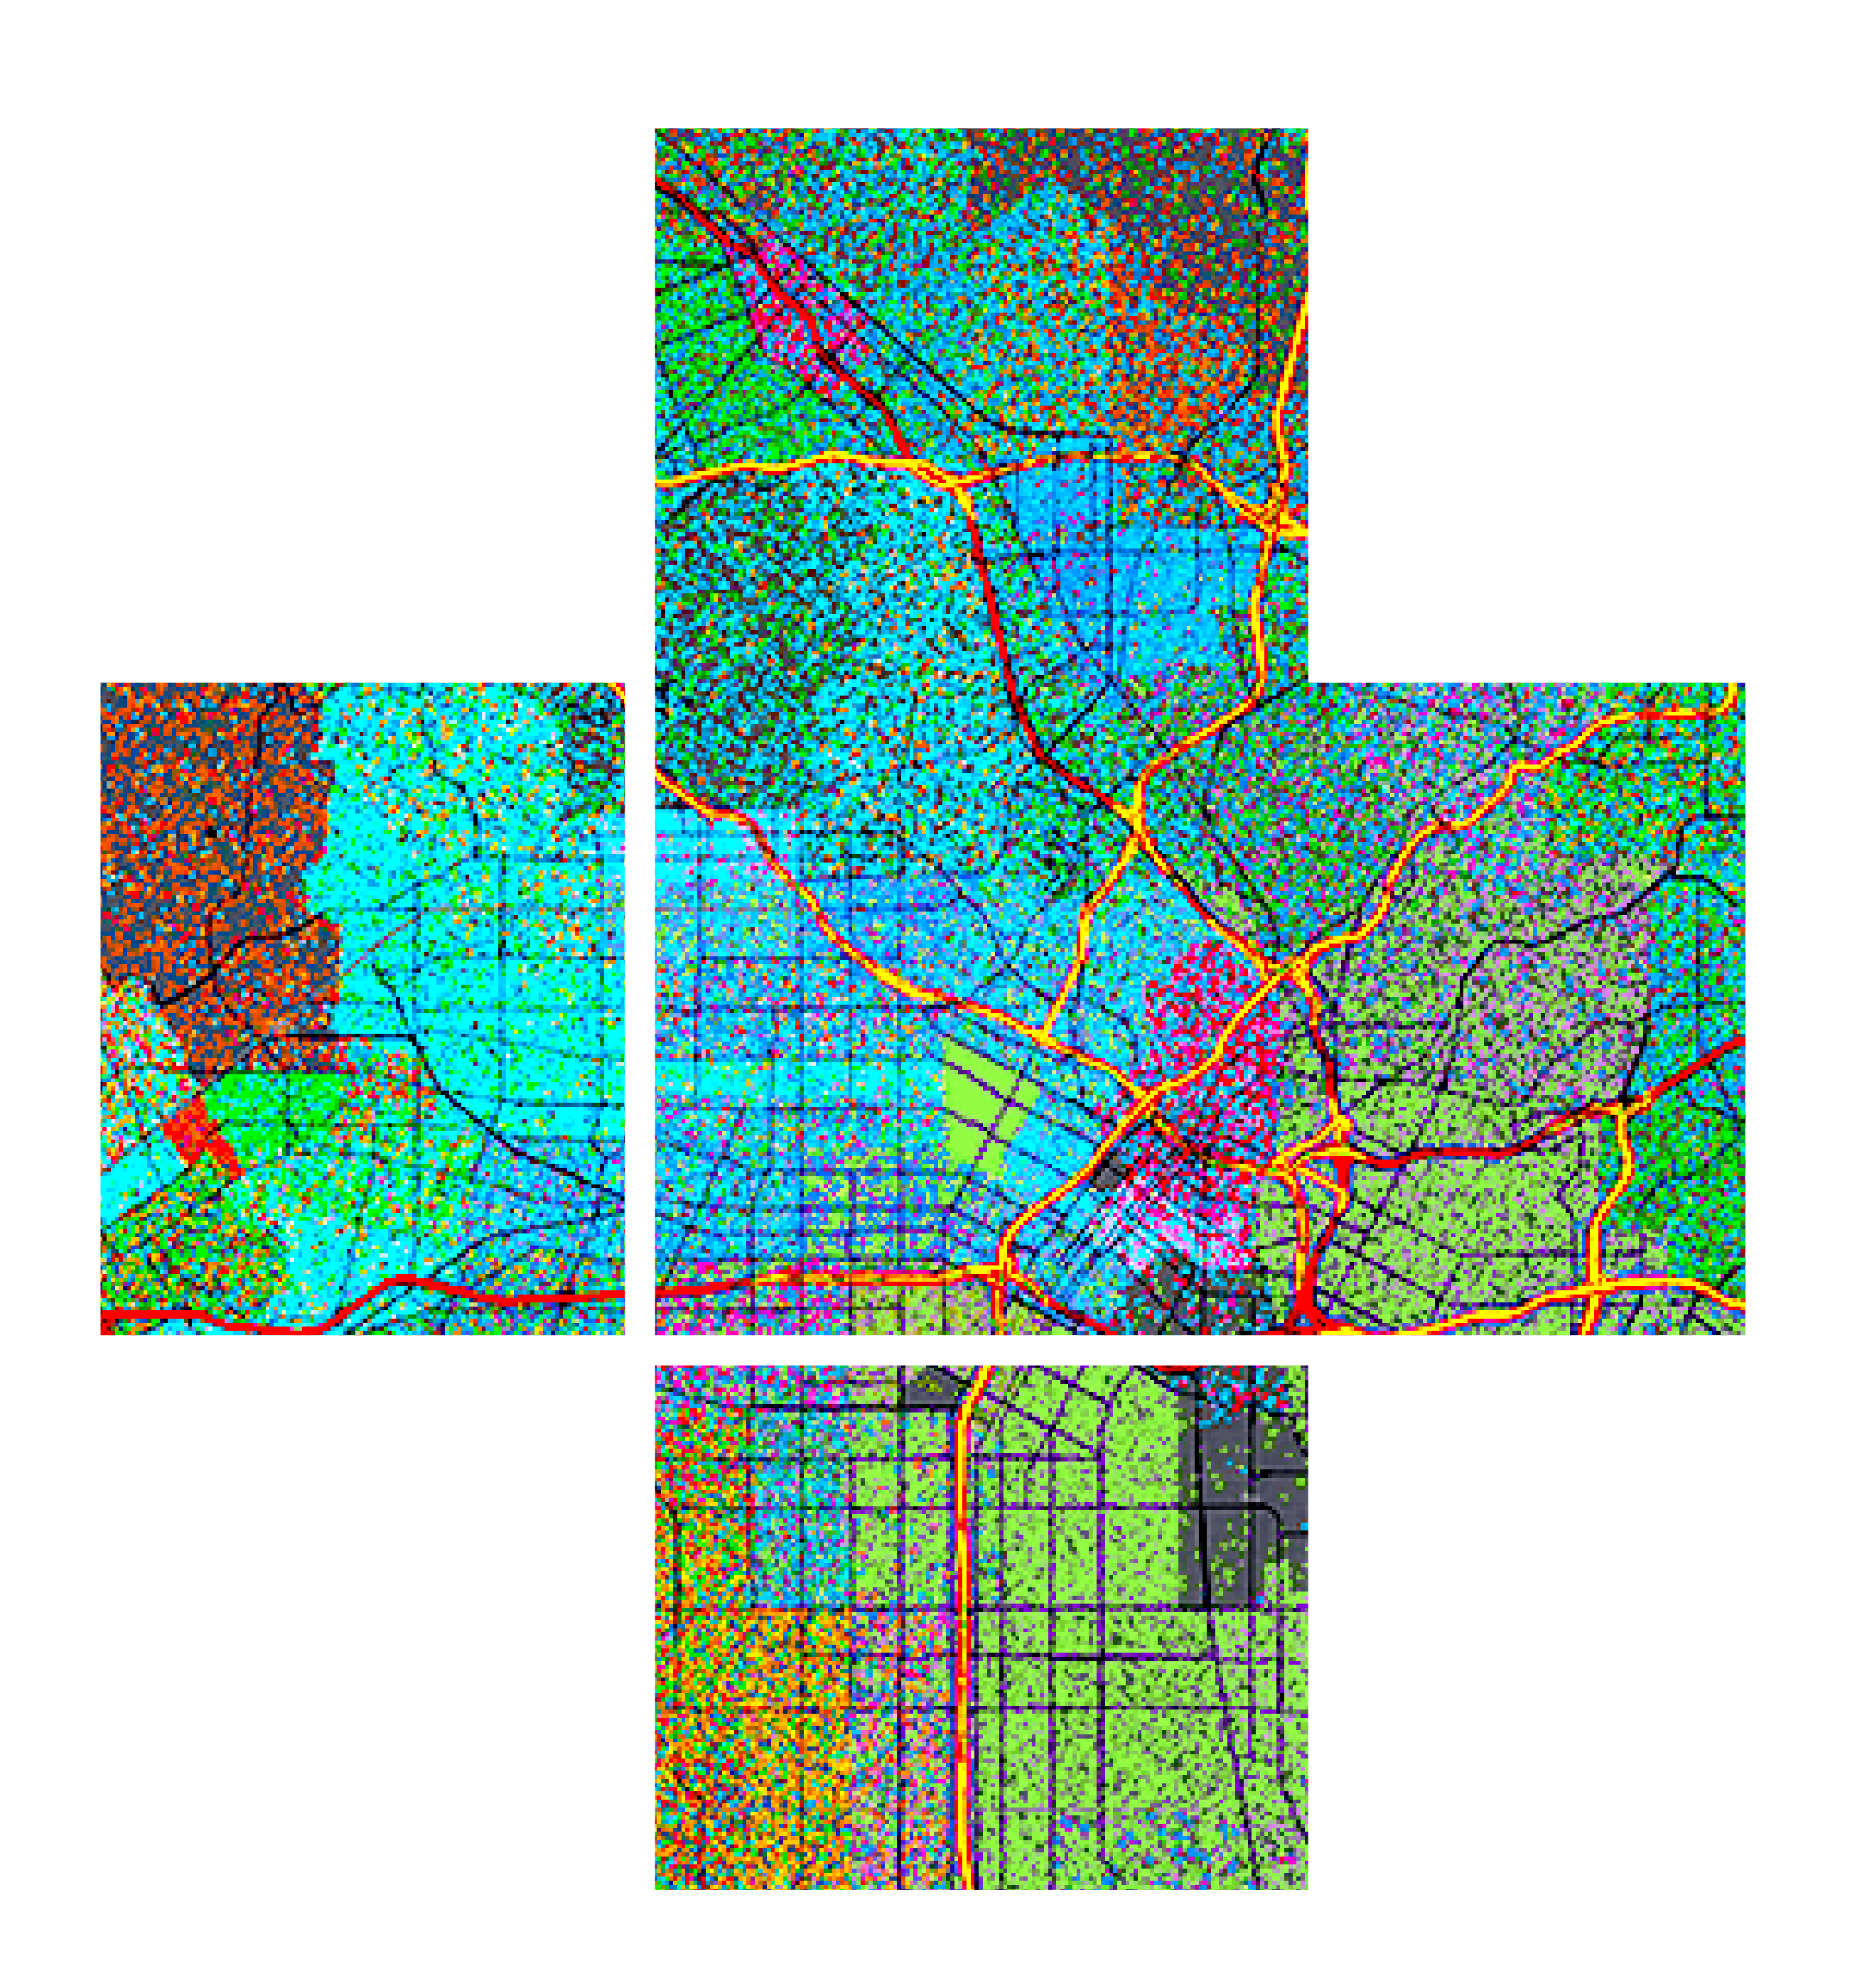








ArcGIS API for JavaScript: Creating Custom Layers and Layer Views
Please leave artwork “+” clustered.
Do not use them alone, as bullet points, or as a “plus” concept. Thank you.
Jacob Wasilkowski @JWasilGeo
2020

Slide 2





Agenda
Intro to custom Layers and LayerViews in JSAPI 4.x
Examples and demos
Deep dive into a custom visualization for a 2D MapView

Slide 3


Finding Our Way
Where to begin making custom Layers and Layer Views

Slide 4
1. Extending JSAPI 4.x with a custom “Layer”
Custom Layer 2D MapView & 3D SceneView
BaseDynamicLayer esri/layers/ BaseDynamicLayer
BaseElevationLayer esri/layers/ BaseElevationLayer
BaseTileLayer esri/layers/ BaseTileLayer

Slide 5
1. Extending JSAPI 4.x with a custom “Layer”
2D MapView or 3D SceneView
Why create a custom layer?
Connect to a service not supported (yet) by the JSAPI
Manipulate data client-side before it is displayed in a 2D MapView or 3D SceneView
Mash up multiple services to create new visualizations
Limitations
Suited for static content
No control over when it redraws
Limited to image formats and tiles

Slide 6
2. Extending JSAPI 4.x with a custom “LayerView”
Custom LayerView 2D MapView only
BaseLayerView2D esri/views/2d/layers/ BaseLayerView2D
BaseLayerViewGL2D esri/views/2d/layers/ BaseLayerViewGL2D

Slide 7
2. Extending JSAPI 4.x with a custom “LayerView”
2D MapView only
Represents the view of a Layer after it has been added to a Map
Responsible for calling a Layer’s API to get data and draw it
Canvas API or WebGL API is exposed to draw anything you want in a 2D MapView
Why? There are no longer HTML nodes representing your geographical features.

Slide 8
3. Extending JSAPI 4.x with custom “externalRenderers”
Custom externalRenderers 3D SceneView only
externalRenderers esri/views/3d/ externalRenderers

Slide 9
3. Extending JSAPI 4.x with custom “externalRenderers”
3D SceneView only
WebGL API is exposed to draw anything you want in a 3D SceneView
Why? There are no longer HTML nodes representing your geographical features.

Slide 10
Demos & Code
Enough words, we want more pictures

Slide 11
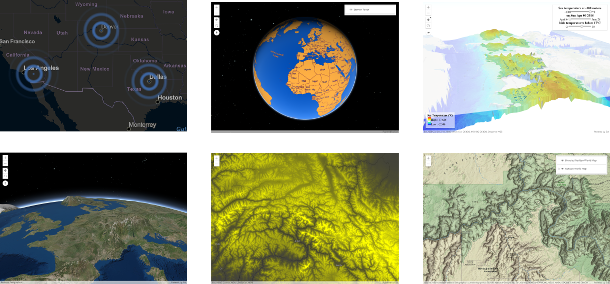
Examples of what’s possible: https://esriurl.com/jsCustomLayers

Slide 12
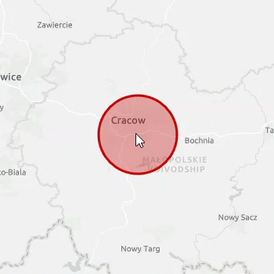

Demo
A deep dive into making a custom and animated BaseLayerView2D
Review a simple GraphicsLayer
Create a static BaseLayerView2D
Animate it!
https://github.com/jwasilgeo/esri-experiments

Slide 13
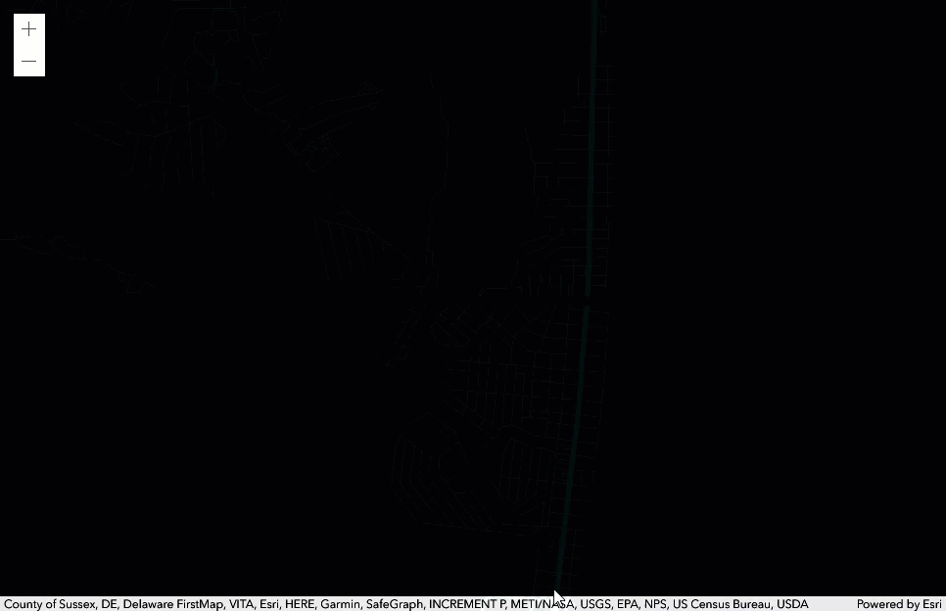
Demo
A custom BaseLayerView2D made by Sean McGee (Esri UK)
https://codepen.io/smcgee/pen/KKpKPxW
@HertsWestUK

Slide 14
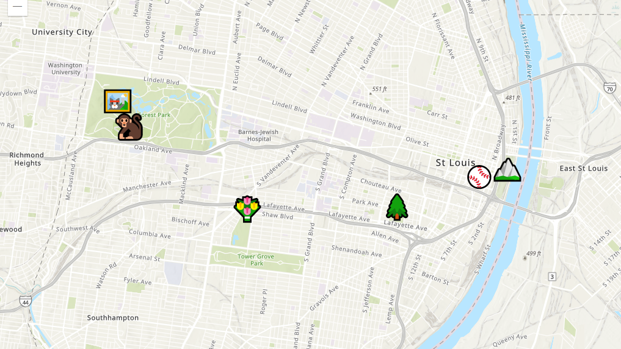
Demo
A custom BaseLayerView2D made by Gavin Rehkemper
https://gavinr.github.io/emoji-map-layer/
@gavinrehkemper
https://github.com/gavinr/emoji-map-layer/blob/master/EmojiLayer.js

Slide 15
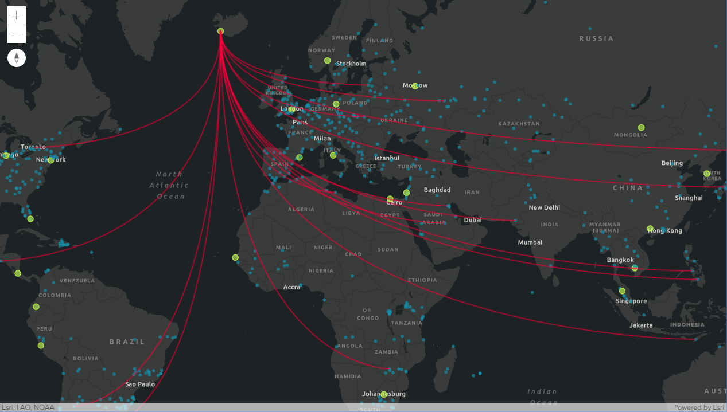
Demo
“Canvas-Flowmap-Layer”
A custom BaseLayerView2D made in collaboration with Sarah Bell
@sarahbellmaps
https://github.com/sarahbellum/Canvas-Flowmap-Layer

Slide 16
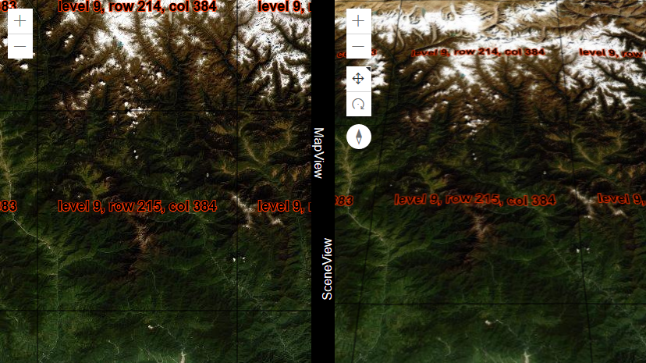
Demo
A custom BaseTileLayer
https://github.com/jwasilgeo/esri-experiments

Slide 17

Demo
“Earth at Night, Mountains of Light”
Built with a custom BaseElevationLayer
https://jwasilgeo.github.io/esri-experiments/earth-at-night/

Slide 18
Resources
These slides are available at
https://github.com/jwasilgeo/presentations
Blog post about “Earth at Night, Mountains of Light”
https://petrichor.studio/2019/02/14/earth-at-night-mountains-of-light/
Dev Summit 2019: “ArcGIS API for JavaScript: Creating Custom Layers and Layer Views”
https://proceedings.esri.com/library/userconf/devsummit19/papers/DevSummitPS_10.pdf
Dev Summit 2018: “ArcGIS API for JavaScript: Creating Custom Layers”
https://proceedings.esri.com/library/userconf/devsummit18/papers/dev-int-018.pdf

Slide 19
Thank you!
Please leave artwork “+” clustered.
Do not use them alone, as bullet points, or as a “plus” concept. Thank you.
Jacob Wasilkowski @JWasilGeo
2020

